Slide 1
Domain Topic: Human-Automation Interaction and Robots in Manufacturing and Warehousing
EIN 4245/6905 – Spring 2024
Dr. Wayne Giang
Lecture 29
March 29, 2024
Slides adapted from Dr. Boyi Hu (Occupational Safety Engineering)

Slide 2
Learning Objectives
Explain the impact of automation on the workplace
Explain the concept of human-robot interaction
Summarize the hazards of human-robot interaction and corresponding injury prevention strategies
Safety precautions when automation and robots are used
Strategies for minimizing the safety problems of automation
Summarize the most pressing challenges in this area

Slide 3
Automation
“Automation is the automatically controlled operation of an apparatus, a process, or a system by mechanical or electronic devices that take the place of human organs of observation, decision, and effort.” (Webster’s Dictionary)
“Automation characterizes the circumstances when a machine (nowadays usually a computer) assumes a task that is otherwise performed by the human operator.” (Wickens and Hollands, 2000)

Slide 4
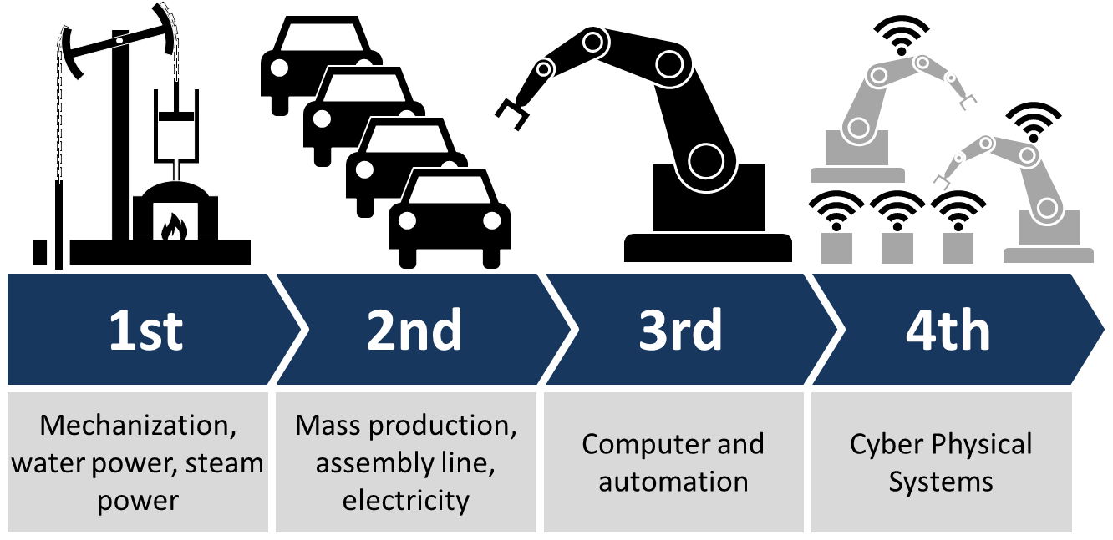
Automation in the Workplace
Goal: enhance productivity, quality and competitiveness
A continuum with different phases:
Age of hand tools and manual work
Age of mechanization (i.e., industrial revolution)
Islands of automation: stand-alone computer, etc.
What’s next?
https://commons.wikimedia.org/wiki/File:Industry_4.0.png

Slide 5
Some HF issues dealing with Automation
How do we choose what functions to automate and what functions to leave to the human?
How reliable should automation be before it is introduced?
How do we deal with how humans adapt to the introduction of the automation?
Trust and adoption, de-skilling, job satisfaction, stress
How can we make it safer for automated systems and humans to work together?
Systems Design + Occupational Safety
Notes:
Try to find the curve from the Science paper that the both ends of workforce are safe and resilient to automation and AI

Slide 6
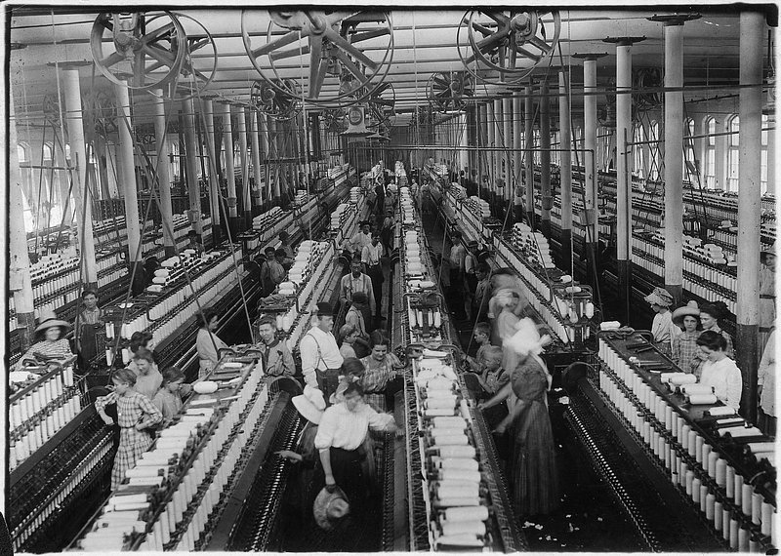
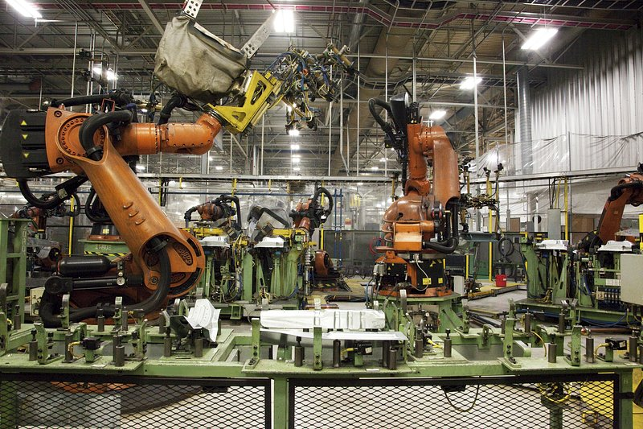
Impact of Automation on the Workplace
Changing the emphasis from physical work to automated mechanical work
Creator: rawpixel.com / U.S. National Archives (Source) | Credit: rawpixel.com / U.S. National Archives (Source)
https://codalien.com/blog/robotics-in-manufacturing-industry/
Notes:
Try to find the curve from the Science paper that the both ends of workforce are safe and resilient to automation and AI

Slide 7
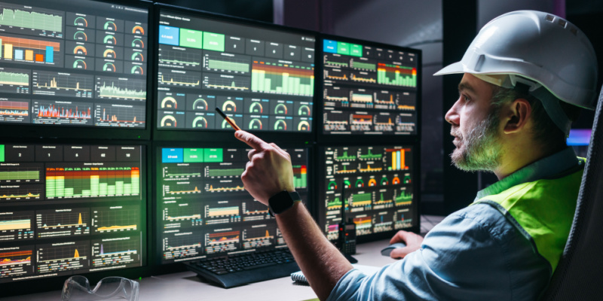
Impact of Automation on the Workplace
Changing the emphasis from physical work to automated mechanical work
Changing the emphasis from physical to mental work
https://www.spiceworks.com/tech/tech-general/articles/what-is-supervisory-control-and-data-acquisition-scada/
Notes:
Try to find the curve from the Science paper that the both ends of workforce are safe and resilient to automation and AI

Slide 8
Impact of Automation on the Workplace
Changing the emphasis from physical work to automated mechanical work
Changing the emphasis from physical to mental work
Increasing the level of stress on workers and supervisors
Eliminating some jobs can cause morale problems
Technology acceptance issue
Making workers feel a loss of control and onset of helplessness
Notes:
Try to find the curve from the Science paper that the both ends of workforce are safe and resilient to automation and AI

Slide 9
Impact of Automation on the Workplace
﻿The main effects of pre-robotics automation have been on a relatively narrow swath of routine, highly structured and repetitive tasks
This has been a key reason that labor demand has fallen for jobs in the middle of the skill and wage spectrum, like clerks and factory workers, whereas demand at the bottom (e.g., janitor or home health aide) and top (e.g., physicians) has held up in most advanced countries
The impacts of new AI technologies may cause another shift in the workplace
Notes:
Try to find the curve from the Science paper that the both ends of workforce are safe and resilient to automation and AI

Slide 10
Impact of Automation on the Workplace
Increased levels of stress:
Rapid, continual change - workers must continually learn and relearn skills with little or no relief
Accompanying feeling of helplessness
Workplace stress
Physiological, psychological and social factors

Slide 11
Domains where automation and robotics are used?

Slide 12
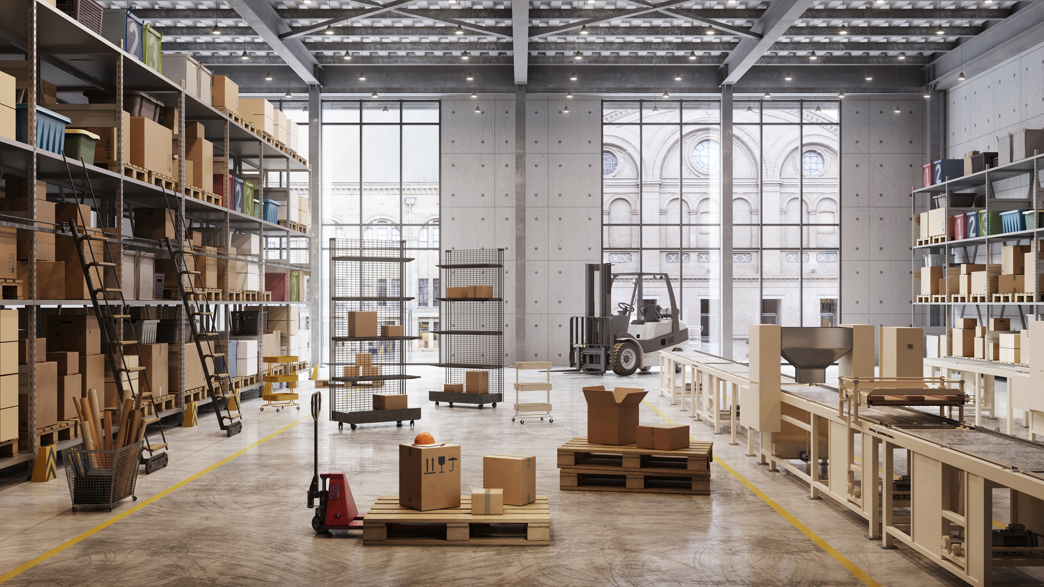

Slide 13
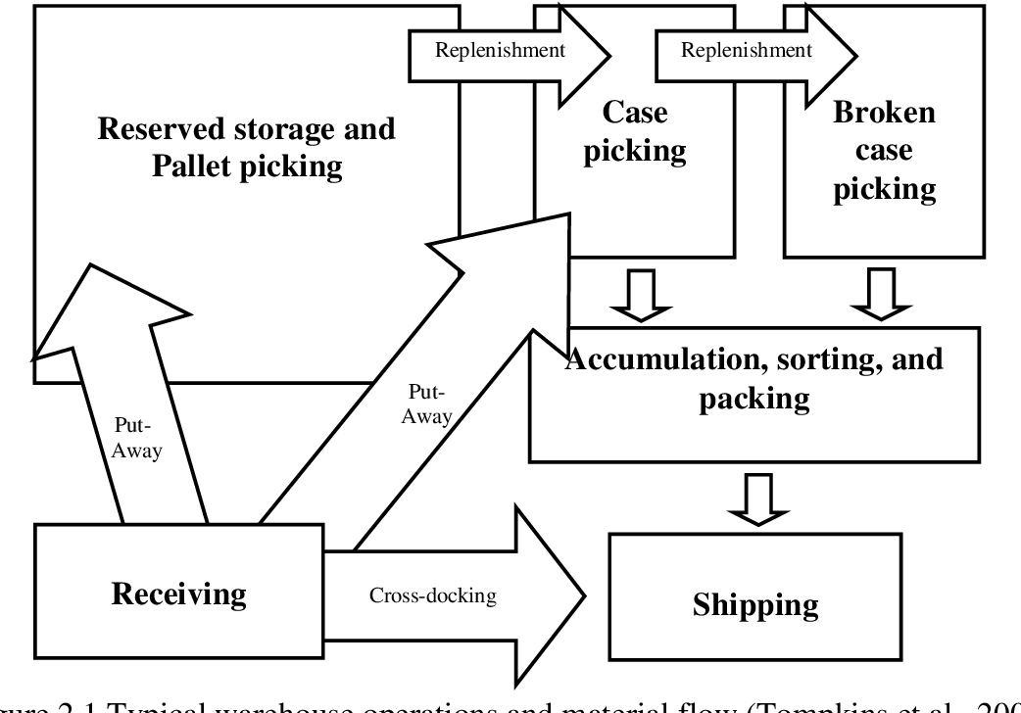
Functions in of a Warehouse or Fulfilment Center
There are many activities that occur as part of the process of getting material into and out of the warehouse
Receiving
Inspection and Quality control
Repackaging
Putaway
Storage
Order picking
Postponement
Sortation of batch
Packing and Shipping
Cross-docking
Replenishing
Kim, B.S. (2009). Dynamic Slotting and Cartonization Problem in Zone-based Carton Picking Systems.

Slide 14
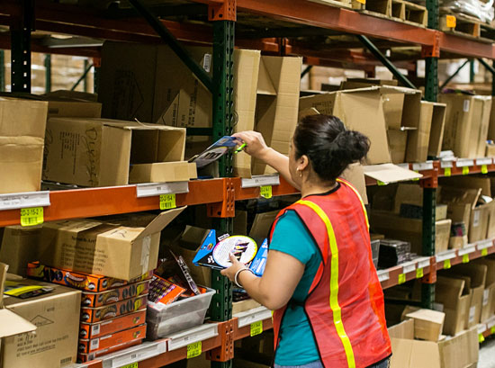
Some jobs within a warehouse
Stower: Person who unloads incoming inventory onto the shelves
Picker: Person who picks the items required for an order from the shelves
Packer: Person who packs the items for shipping
https://www.cisco-eagle.com/blog/2018/04/12/order-picking-velocity-storage-and-picking-method-comparisons/
Notes:
Roles in a fulfilment center
Stower
Picker
Packer
We saw picker and packer in the video
Someone needs to load the shelves and robots.

Slide 15

https://youtu.be/M32JRrVoVhQ

Slide 16
Are risk factors being changed by Automation?
Reduce the number of low-force repetitive movements
Twisting, pinching and flexing – reduce risk of MSDS
Not necessarily the case always
Example: warehouse workers
Traditional: walking 12 miles a day for order picking, 100 items per shift
Amazon smart warehouse: minimal walking distance, 100 items per hour

Slide 17
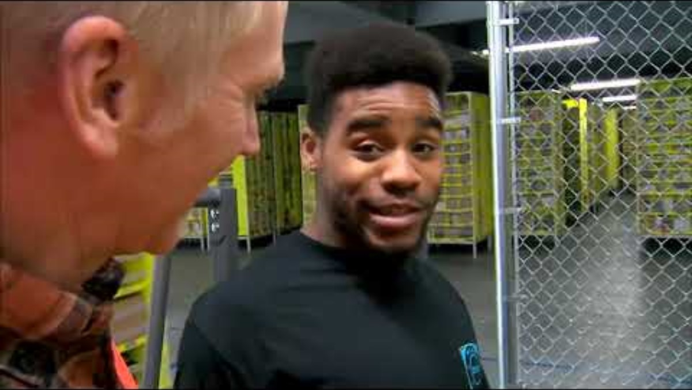
Amazon Fulfilment Center
https://youtu.be/eUQeWa8l1aA

Slide 18
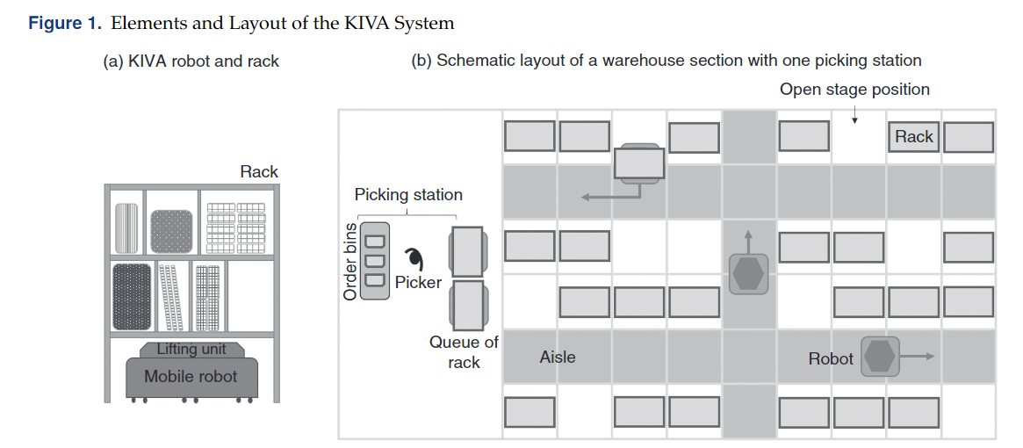
Weidinger, F., Boysen, N., & Briskorn, D. (2018). Storage assignment with rack-moving mobile robots in KIVA warehouses. Transportation science, 52(6), 1479-1495.
Notes:
Amazon Kiva:
Early days: https://www.youtube.com/watch?v=6KRjuuEVEZs
Current: https://www.youtube.com/watch?v=TUx-ljgB-5Q (safety vest)
https://www.youtube.com/watch?v=JXkMevbjga4 (warehouse)
Walmart:
https://www.youtube.com/watch?v=AqAPFXNyF4M AlphaBot

Slide 19
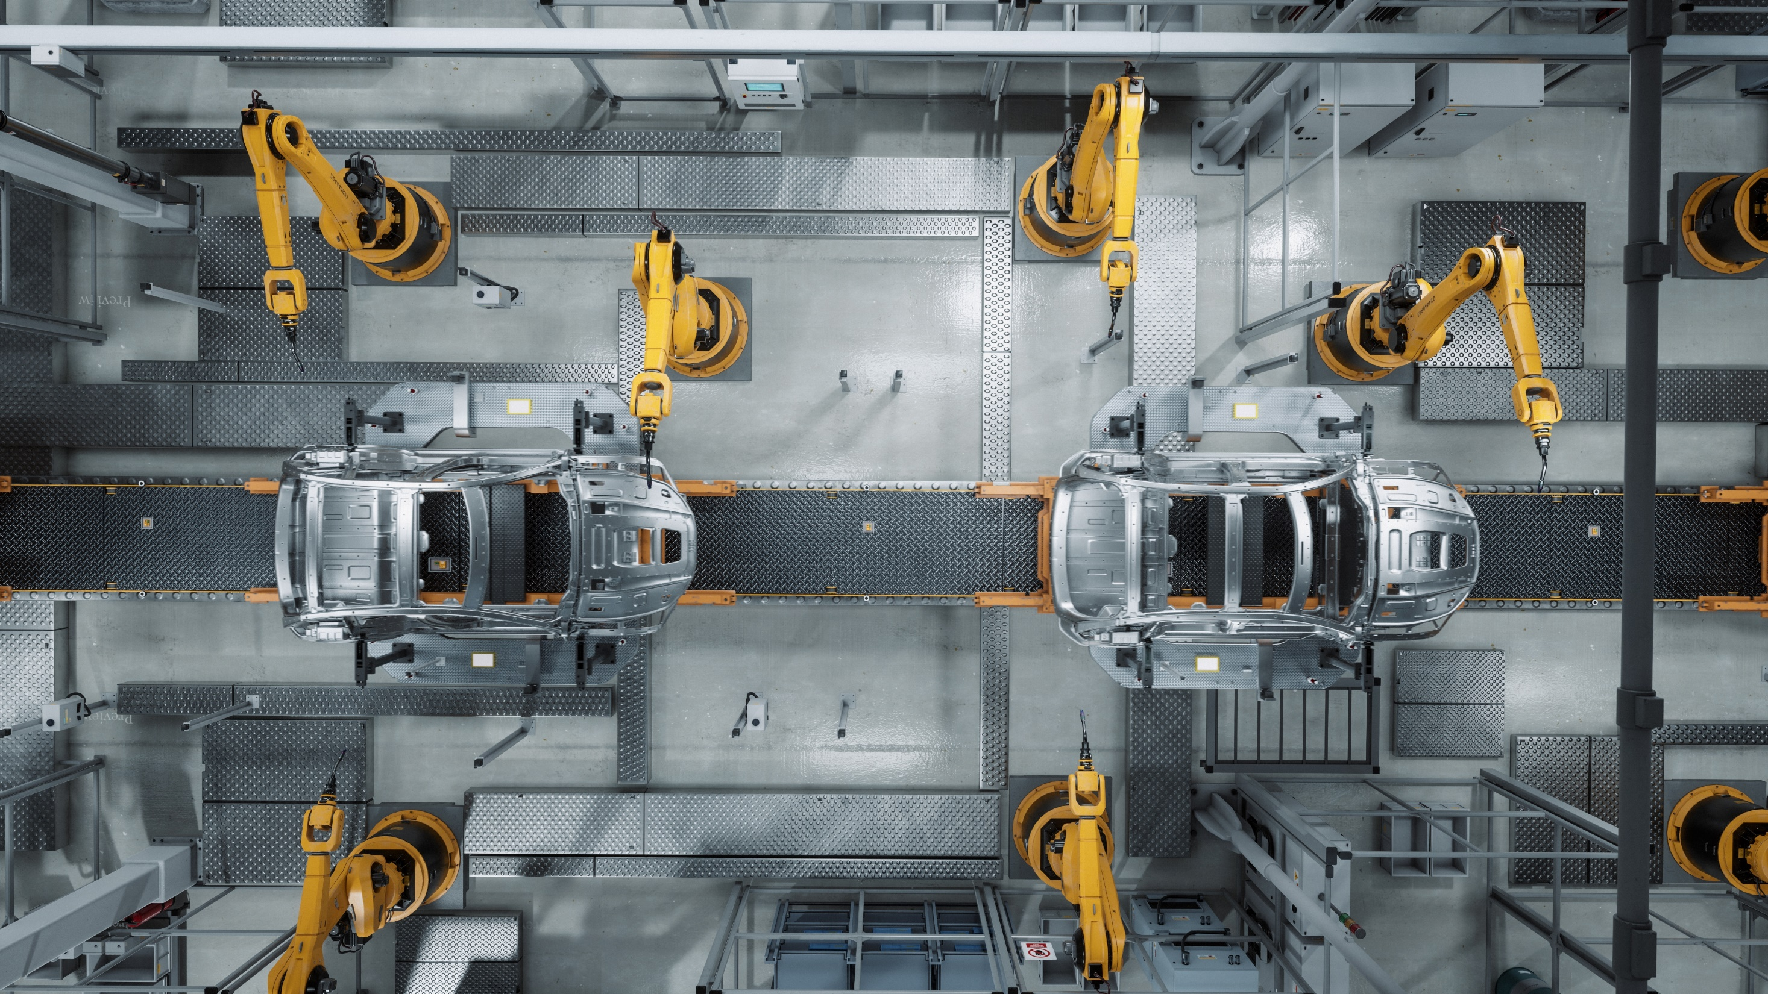

Slide 20
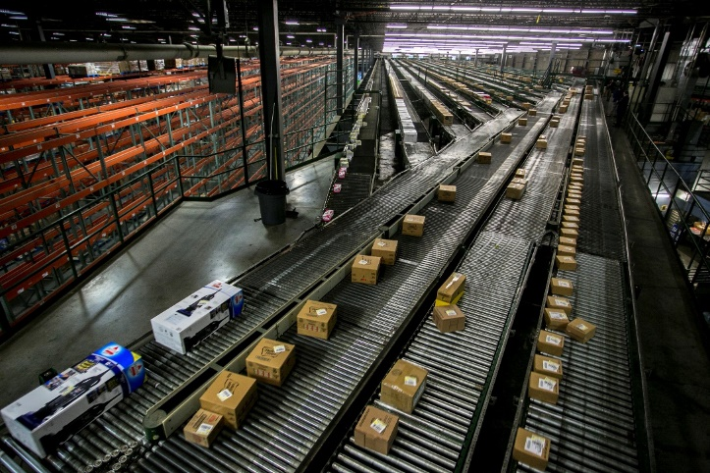
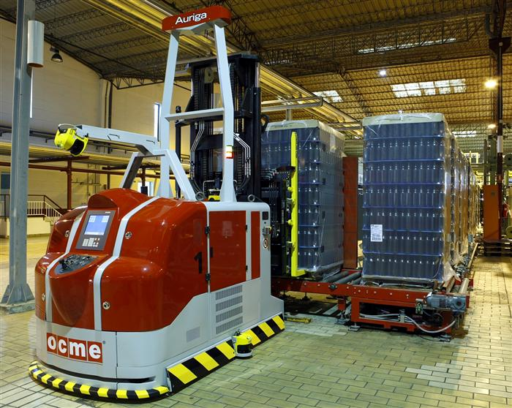
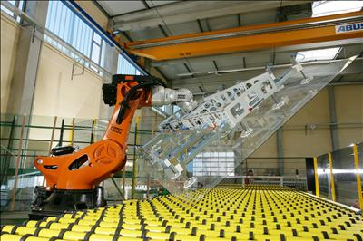
Material Flow Systems in Manufacturing
Material Handling
The flow patterns in manufacturing can be automated
Mechanized and automated systems like running conveyors, shuttle carts, automated guided vehicles, robots and other devices.

Slide 21
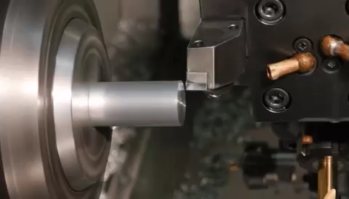
Manufacturing Methods
CNC Machining
Manual or Automated
Can have multiple axis
https://www.youtube.com/watch?v=8cp4eCXnc4Q
Lathe
Turn the part and use a tool to make the shape
Turning a square part - https://www.youtube.com/watch?v=-2ygW0fSnjg
Casting
Using some kind of mold (sand, wax, etc) and filling with material (usually metal)
https://www.youtube.com/watch?v=LmjAQGvSrF0Injection Molding
https://www.youtube.com/watch?v=pwaXCko_Tkw
Most common
Uses high temperature and high pressure to “inject” material into a mold cavity
Additive Manufacturing (3D printing)

Slide 22
Car Manufacturing Tasks
Assembly
Painting
Welding
Machine tending (load or unload parts, materials, tools from a machine)
Material removal and polishing
Quality inspection
Notes:
Car Painting: https://www.youtube.com/watch?v=ViDAohrBEu4

Slide 23
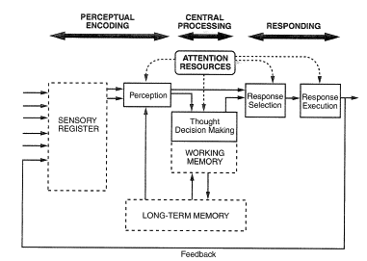
Wickens et al Model of Human Information Processing
Notes:
What does the human do in each of these steps? What parts are automated?
Assembly -> perceive parts, choose action -> execute action
Painting -> perceive places that require painting, plan path of motion, execute action
Quality Inspection -> perceive product, identify potential issues, indicate issue is present

Slide 24
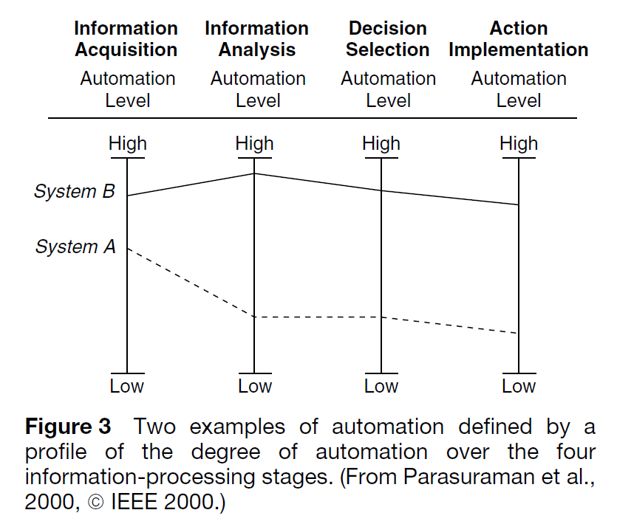
Types and Levels of Automation
Notes:
What parts should be automated, at to what level do we want to automate it?
Perceptual cueing -> AI helps detect possible hazards, human makes the decision and acts on it
Painting: robot does all steps automatically, human supervises

Slide 25
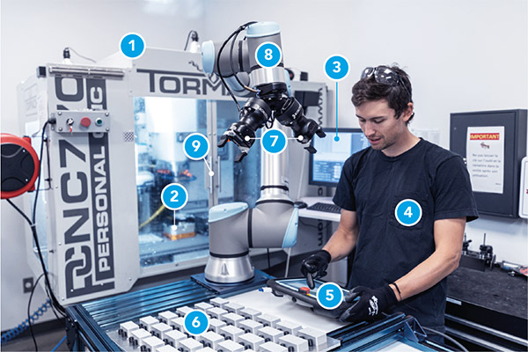
Co-bots in a CNC cell
Co-bots are collaborative robots designed to work safely alongside humans.
They can perform tasks in a CNC cell such as loading and unloading workpieces, tool changes, and part inspection.
https://robotiq.com/applications/machine-tending

Slide 26
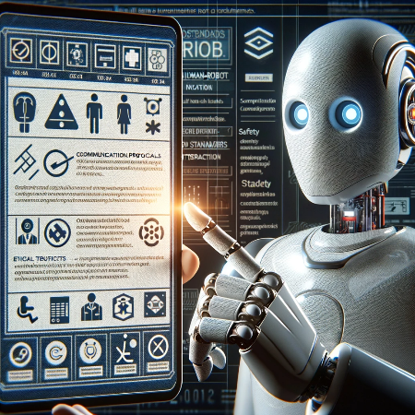
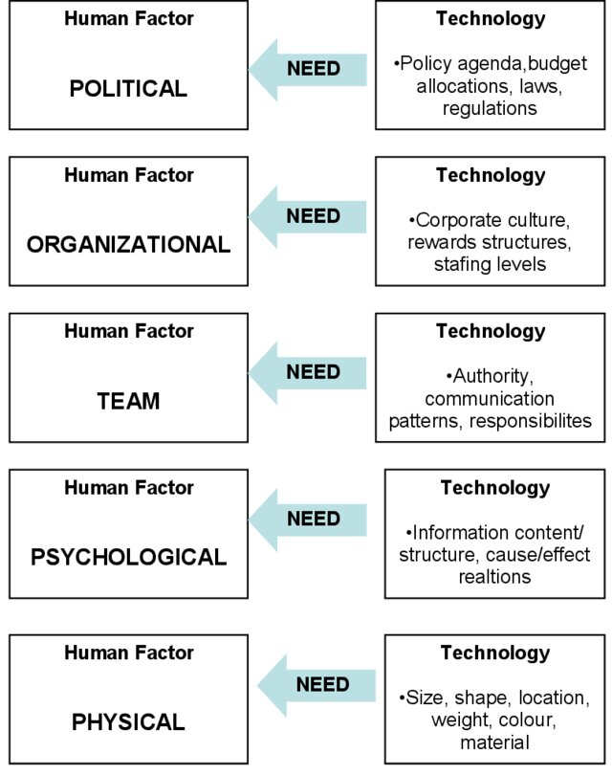
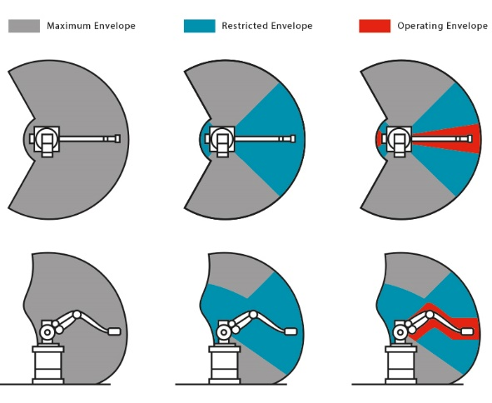
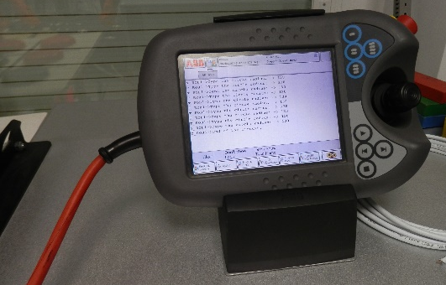
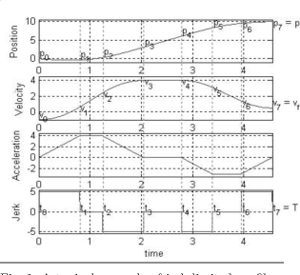
Human-Robot Interaction across Vicente’s Human Tech Ladder
https://www.distrelec.de/en/industrial-robots/cms/knowhow-industrial-robots
https://commons.wikimedia.org/wiki/File:Teach_Pendant_ABB.JPG
Kozey, J. –An Application of Human Factors in Life Support Equipment and Emergency Egress. Survival at Sea for Mariners, Aviators and Search and Rescue Personnel.
Jeong, S. Y., Choi, Y. J., Park, P., & Choi, S. G. (2005). Jerk limited velocity profile generation for high speed industrial robot trajectories. IFAC Proceedings Volumes, 38(1), 595-600.

Slide 27
Human Robot Interaction – A brief intro
Every tool to enhance human work efficiency comes with new safety and health hazards. For robots:
The ability to acquire intelligence (ethical issues), examples?
Surgical robots, driverless cars, unmanned weapons
Their flexibility and range of motion
Speed of movement
Power
Endurance
Direct and indirect interaction, frequent and occasional interaction, remote or proximity interaction
Notes:
Science paper:
https://science.sciencemag.org/content/sci/352/6293/1573.full.pdf

Slide 28
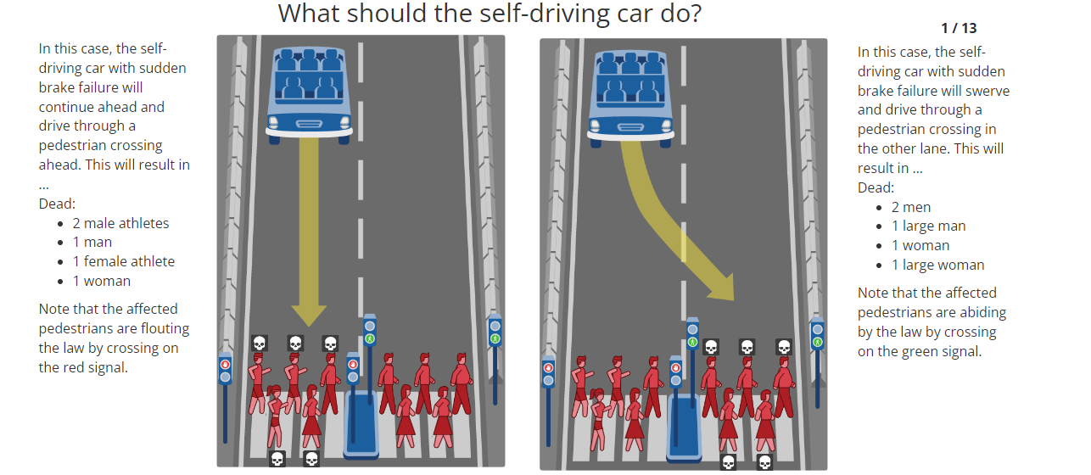
Let Us Discuss
https://www.moralmachine.net/
Notes:
Science paper:
https://science.sciencemag.org/content/sci/352/6293/1573.full.pdf
https://www.moralmachine.net/

Slide 29
Safety and Health Problems with Robots
General principal hazards associated with robots (by National Safety Council)
Struck by a moving robot while inside the work envelope
Trapped between a moving part of robot and another machine
Struck by a workpiece, tool or object dropped or ejected by a robot
NIOSH FACE case (https://www.cdc.gov/niosh/face/in-house/full8420.html)
Autonomous car fatality (Uber)

Slide 30
Safety and Health Problems with Robots
Between 1992 and 2017 there were a total of 41 robot-related deaths, of which 78% of the cases involved a robot or robot-controlled operation physically striking a human worker (Layne, 2023).
General principal hazards associated with robots (by National Safety Council)
Struck by a moving robot while inside the work envelope
Trapped between a moving part of robot and another machine
Struck by a workpiece, tool or object dropped or ejected by a robot

Slide 31
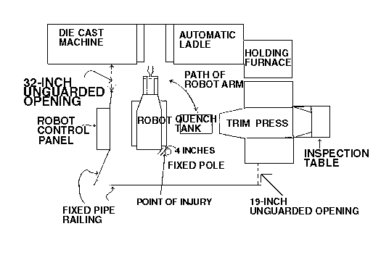
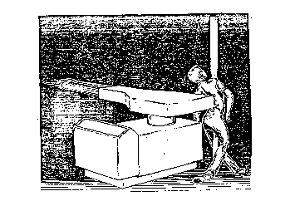
NIOSH – Die Cast operator Pinned by Robot (1980)
Experienced operator working with automated die cast system using a Unimate Robot.
Robot programmed to extract the casting from die-cast machine, dip into a quench tank, and insert it into automatic trim press.
Operator entered working area of robot and was pinned between the right rear of the robot and a safety pole in a slumped but upright position.
Operator trained against entering working area of robot, and had recently attended a course.
Fellow workers struggled with using teach pendant to control the robot to unpin the victim.
https://www.cdc.gov/niosh/face/In-house/full8420.html

Slide 32
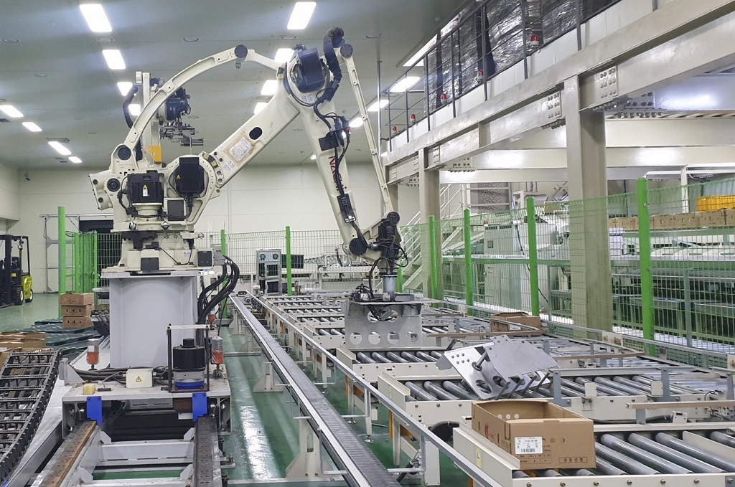
Industrial Robot Accident – South Korea (2023)
Pick-and-place robot used in vegetable packaging facility.
Worker had been checking the robot’s sensor operations.
Robot failed to distinguish worker from the boxes of vegetables
Robot arm grabbed him and forcibly propelled his body against the conveyor belt.
Officials stated that robot’s sensors were designed to identify boxes but was not a sophisticated robot.
https://www.bbc.com/news/world-asia-67354709
https://www.cbsnews.com/news/industrial-robot-crushes-worker-dead-south-korea/

Slide 33
Minimizing the Safety and Health Problems
Barrier, no enter zone
Effective in certain scenarios, have strong weakness
Ensure glare-free, well-lighted robot site
Good housekeeping
Keep the robot site free of associated hazards such as blinding light from welding machines
Equip electrical and pneumatic components of the robot with fixed covers and guards
Make sure all safeguards are in place before starting
Lockout and proper test procedures
Notes:
From a safety professional perspective
Preventive approaches after robots have been developed

Slide 34
Minimizing the Safety and Health Problems
Construction of a safety fence – work envelope
Control the speed of movement inside the work fence
Installation of emergency stop device
Location of the control panel outside the safety fence
Establishment of automatic shutdown switches

